Slide 1
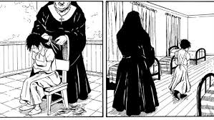
Residential Schools
Genocide in Canada

Slide 2
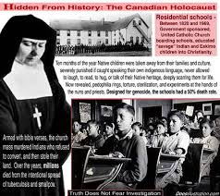
Residential Schools
Residential schools were schools where the children lived away from their parents.
Their parents didn’t choose this for them, they were forced to send their children there.
The Canadian government came to the First Nations reserve and rounded up all the kids
The purpose of the schools were to ‘kill the Indian in the child’.

Slide 3
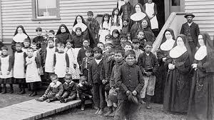
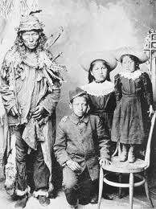
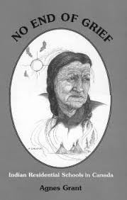
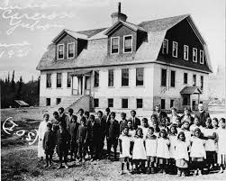
Administration
The schools were run by the Christian churches, sanctioned by the government.
Nuns were the teachers and there was usually a priest as well
It became the norm to treat the children like little animals. Often the nuns were cruel and heartless.
Some of the children were quite young. The youngest child would have been about 3 years old.

Slide 4
Typical Day in the School
These schools weren’t like other schools. The focus was on erasing the ‘Indian in the child’, not actual learning.
6:00am wash, dress and clean up the dorms
6:30am to the chapel (church) for Latin mass then morning chores
Class time consisted of religious training (1 hr), reading, writing and mathematics (2 hrs). Non-native schools had 5 hrs of instruction
After lunch, native children would begin their "civilization" training: farming, gardening, cooking, sewing and cleaning.
They would have one hour of study time in the evening, supper, clean-up, supervised recreation, prayer and bedtime.

Slide 5
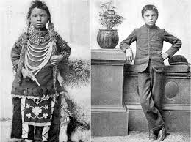
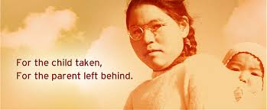
Genocide
This entire system of school was a cultural genocide.
Thousands of children died at these schools from bad treatment and food.
They were not allowed to speak their language
They were forced to practice a new religion (Christianity)
Abuse of the children was accepted practice. It was thought that the people who ran the schools must be harsh in order to be effective

Slide 6
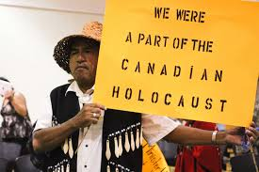
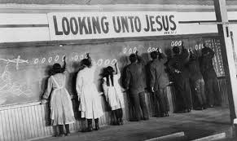
Abuse
Children were sexually abused at these schools
They were beaten and physically punished for almost anything
They were being used for nutritional and medical experiments by the Canadian government (this has just newly come to the attention of the Canadian public)
Many of them tried to escape and died on the way home
They were not allowed to see their parents because the school worried that this would damage the progress they had made

Slide 7
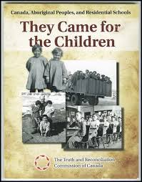
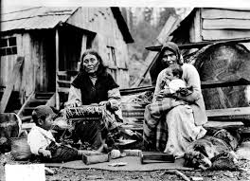
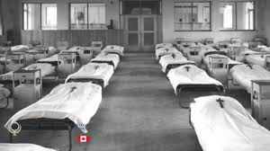
Why?
Why did they do it?
Ethnocentricity: believing your culture is the only right one.
Xenophobia: being afraid of other cultures.
Personally, I wonder if the government and the settlers felt threatened because they sensed the strength in the people they tried to destroy.
The nuns and teachers thought they were doing the right thing, trying to assimilate those Indian children into the mainstream Canadian culture

Slide 8
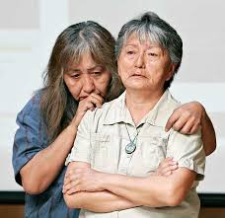
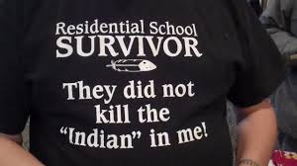
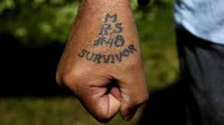
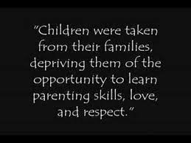
Results?
Generations of broken, damaged people. Thousands of people who now rely on the government to fix the problem because the methods they used to fix things in the past are not known to them.
NOT assimilation. It didn’t work!
The people who are damaged by the residential school system have passed down abuse and alcohol dependence on their own children, who have passed it to theirs.
Many of them do not like schools and do not pass along a respect for school and formal education to their children and grandchildren, resulting in a lack of graduation rates for this current generation.

Slide 9
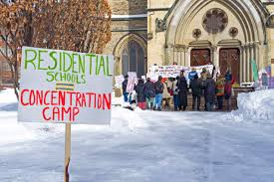
Solution?
Time
The government has finally apologized to the survivors of the residential school system. This happened about 7 years ago.
The impact of the schools is unknown but some people think it will take 10 generations to repair the damage. We are on the 2nd generation in schools right now.

